Slide 1
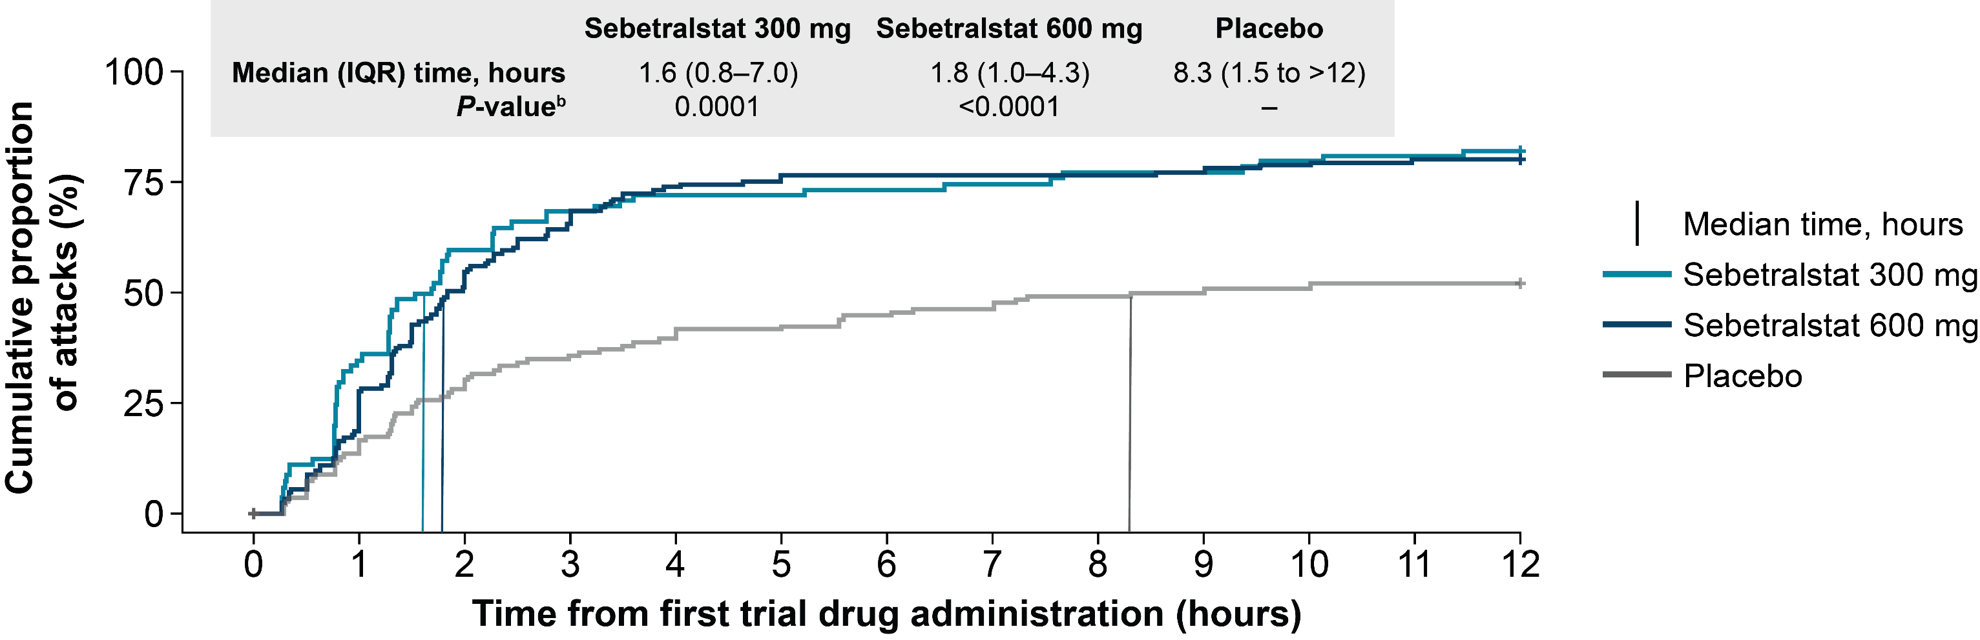
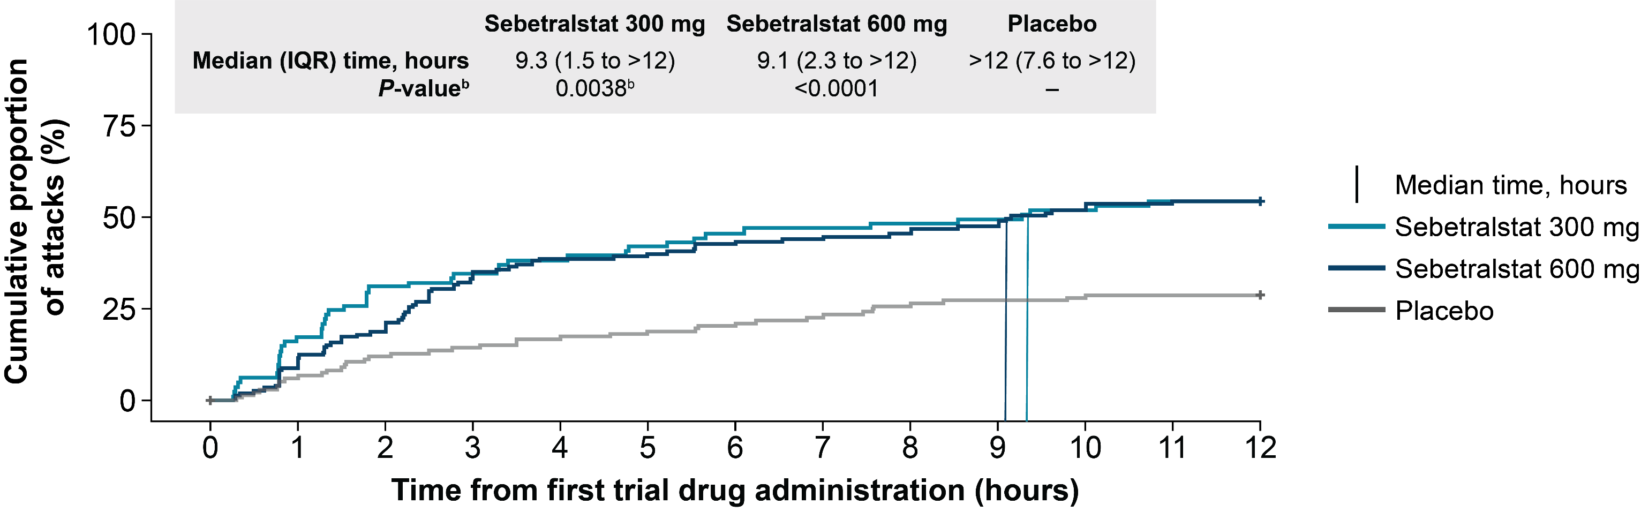
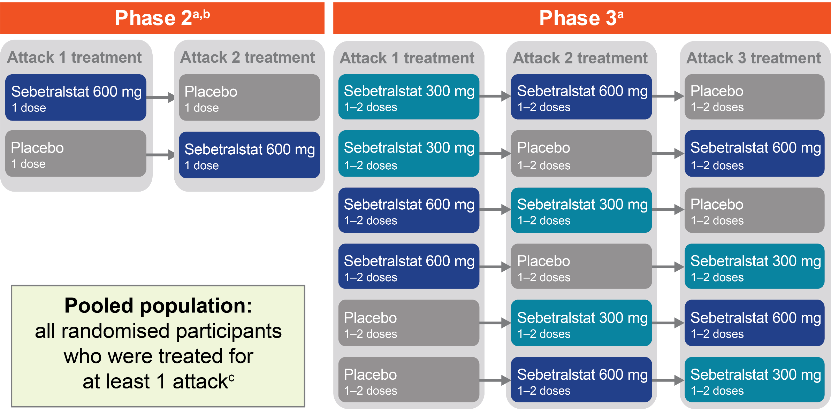
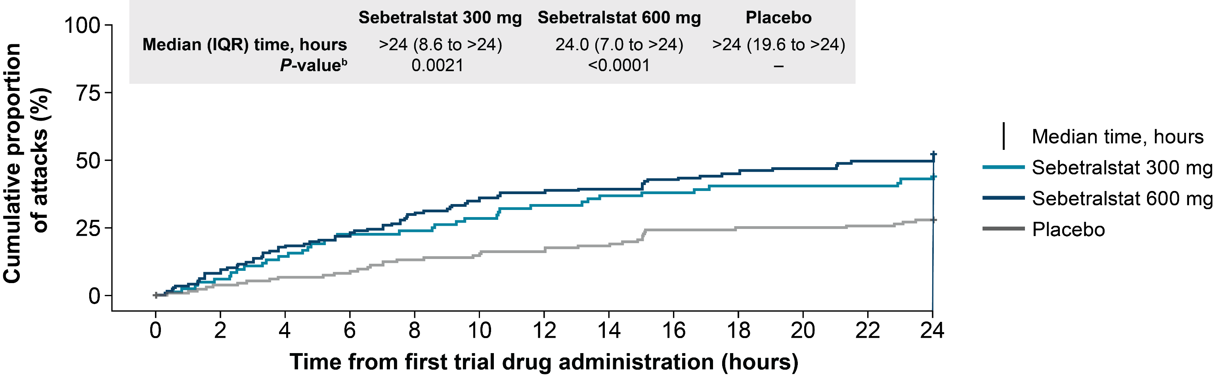
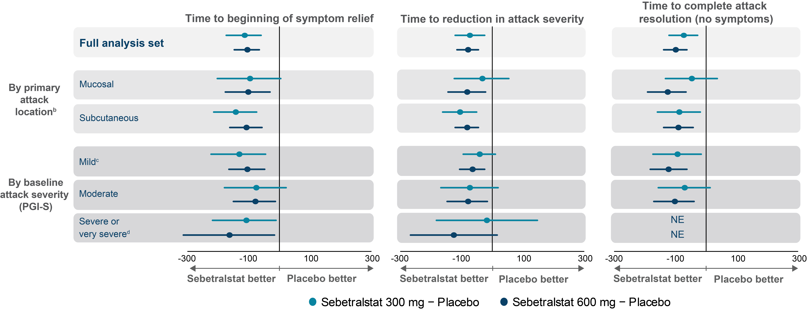
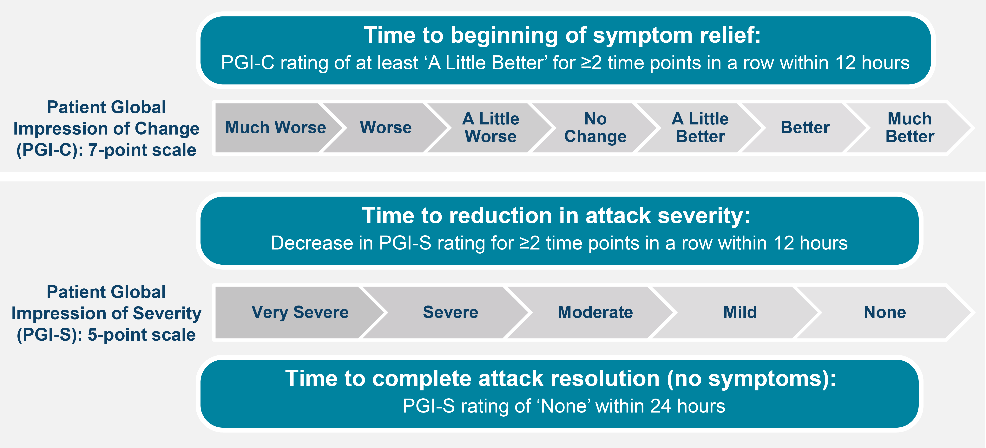
P.32
Efficacy and Safety of Sebetralstat for On-demand Treatment of Hereditary Angioedema in Pooled Analysis of Placebo-controlled Clinical Trials
Patrick F. K. Yong,¹ Jonathan A. Bernstein,² Danny M. Cohn,³ Henriette Farkas,⁴ William R. Lumry,⁵ Marc A. Riedl,⁶ Andrea Zanichelli,^{7,8} James Hao,⁹ Michael D. Smith,⁹ Christopher M. Yea,⁹ Paul K. Audhya,⁹ Emel Aygören-Pürsün,¹⁰ Sinisa Savic,¹¹ Sorena Kiani-Alikhan¹²
¹Frimley Health NHS Foundation Trust, Frimley, United Kingdom; ²University of Cincinnati College of Medicine, Cincinnati, OH, United States; ³Amsterdam UMC, University of Amsterdam, Amsterdam, Netherlands; ⁴Hungarian
Angioedema Center of Reference and Excellence, Semmelweis University, Budapest, Hungary; ⁵AARA Research Center, Dallas, Texas, United States; ⁶University of California – San Diego, La Jolla, California, United States; ⁷IRCCS Policlinico San Donato, San Donato Milanese, Milan, Italy; ⁸University of Milan, Milan, Italy; ⁹KalVista Pharmaceuticals, Salisbury, United Kingdom, and Cambridge, Massachusetts, United States; ¹⁰University Hospital Frankfurt, Goethe University, Frankfurt, Germany; ¹¹University of Leeds, Leeds Institute of Rheumatic and Musculoskeletal Medicine, Leeds, United Kingdom; ¹²Royal Free London NHS Foundation Trust, London, United Kingdom
Background
Figure 3. Time to beginning of symptom reliefª
The World Allergy Organization/European Academy of Allergy and Clinical Immunology (WAO/EAACI) guidelines recommend that all HAE attacks are considered for treatment regardless of severity or location, and to treat as early as possible^{1,2}
Parenterally administered on-demand therapies for HAE are associated with side effects and administration burden leading to delay or withholding of treatment²⁻⁴
Sebetralstat was the first orally administered on-demand therapy to be evaluated in phase 2 and 3 clinical trials (Figure 1) whose designs were consistent with the WAO/EAACI guideline recommendations^{1,5,6}
  Efficacy endpoints included beginning of symptom relief on the Patient Global Impression of Change (PGI-C) scale as well as reduction in severity and complete attack resolution on the Patient Global Impression of Severity (PGI-S) scale^{5,6} (Figure 2)
  Similarities in endpoints and trial designs allowed for pooling of efficacy and safety data to evaluate sebetralstat in a larger cohort of attacks
Objective
IQR, interquartile range; PGI-C, Patient Global Impression of Change.
ªRating of ≤‘A Little Better’ on the PGI-C scale for ≥2 time points in a row within 12 hours of trial drug administration. ^{b}Adjusted P value compared with placebo.
To evaluate the efficacy and safety of sebetralstat for on-demand treatment of HAE attacks in the pooled, randomised, double-blind, placebo-controlled, crossover phase 2 and 3 trials
Figure 4. Time to reduction in attack severityª
Methods
Participants had confirmed HAE-C1INH, were aged ≥18 years (phase 2) or ≥12 years (phase 3), received ≥1 dose of study drug, had ≥3 (phase 2; mild to moderate; neck and above excluded) or ≥2 (phase 3; mild to very severe; all locations; excluding severe laryngeal only) attacks in the past 3 months, and had a stable dose of long-term prophylaxis (phase 3)
Figure 1. Trial designs
IQR, interquartile range; PGI-S, Patient Global Impression of Severity.
ª≤1-level reduction from baseline in PGI-S rating for ≥2 time points in a row within 12 hours of trial drug administration. ^{b}Adjusted P value compared with placebo.
Figure 5. Time to complete attack resolution (no symptoms)ª
ªA minimum 48-h washout period was required between each eligible attack and, therefore, each dose of trial drug. ^{b}Only the randomised, double-blind, placebo-controlled part 2 of the phase 2 trial is included in the pooled analysis. ^{c}The pooled efficacy population was analyzed based on the planned treatment; 1 participant randomised to receive sebetralstat 300 mg and 1 participant randomised to placebo each received sebetralstat 600 mg; the pooled safety population was analyzed based on the actual treatment participants received.
IQR, interquartile range; PGI-S, Patient Global Impression of Severity.
ªPGI-S rating of ‘None’ within 24 hours of trial drug administration. ^{b}Adjusted P value compared with placebo.
Assessments were recorded in both trials every 0.5 hours for the first 4 hours after first taking the study drug
After which:
  For phase 2, every hour from 4–12 hours, every 3 hours from 12–24 hours, and once at 36 and 48 hours
  For phase 3, every hour from 5–12 hours, every 2 hours from 14–24 hours, and once at 36 and 48 hours
P-values were calculated using Gehan score transformation test and not adjusted for multiplicity
Figure 2. Efficacy outcome measures
Figure 6. Efficacy outcomes in subgroups, treatment differences (95% CI)ª
CI, confidence interval; PGI-S, Patient Global Impression of Severity.
ªLeast square means differences from placebo in Gehan scores. ^{b}Baseline primary pooled attack locations: mucosal: an attack with larynx/throat, abdominal only, or abdominal and subcutaneous; subcutaneous only: an attack with arms/hands, genitals, legs/feet, head/face/neck, or torso location(s) only; a subgroup analysis of laryngeal attacks was not feasible because only 8 of these attacks occurred: the 300-mg and 600-mg doses were administered after 2 attacks each and placebo after 4. ^{c}Baseline PGI-S score was ‘None’ for 2 attacks in the placebo group. ^{d}Treatment difference for time to beginning of symptom relief shown for the severe or very severe subgroup treated with the sebetralstat 300 mg dose are for the phase 3 trial only. NE is indicated where pooled statistics were not possible due to small sample size.
PGI-C, Patient Global Impression of Change; PGI-S, Patient Global Impression of Severity.
Table 3. Treatment-emergent adverse events
Results
Number of participants, n (%) | Sebetralstat 300 mg (n=86) | Sebetralstat 600 mg (n=151) | Placebo (n=138)
Any TEAE Treatment-related TEAEª | 17 (19.8) 2 (2.3) | 28 (18.5) 6 (4.0) | 24 (17.4) 6 (4.3)
Any serious TEAE Treatment-related serious TEAE^{b} | 1 (1.2)^{d} 0 | 2 (1.3) 0 | 0 0
Any severe TEAE Treatment-related severe TEAE^{c} | 1 (1.2)^{d} 0 | 0 0 | 0 0
Any TEAE leading to trial discontinuation | 0 | 0 | 0
Any TEAE leading to death | 0 | 0 | 0
Table 1. Pooled characteristics of participants treated with sebetralstat or placeboª
 | Sebetralstat |  | Placebo n=139 | Participants in the UK n=15^{b}
 | 300 mg n=87 | 600 mg n=151
Age, mean (SD) years | 37.2 (14.7) | 38.0 (14.1) | 38.5 (14.5) | 35.0 (12.8)
Age group, n (%) Adolescent, ≥12 to <18 years Adults, ≥18 to <65 years Geriatric, ≥65 years | 10 (11.5) 75 (86.2) 2 (2.3) | 11 (7.3) 136 (90.1) 4 (2.6) | 9 (6.5) 126 (90.6) 4 (2.9) | 1 (6.7) 14 (93.3) 0
Sex, female, n (%) | 54 (62.1) | 86 (57.0) | 82 (59.0) | 10 (66.7)
Race, n (%) White Black Asian Other or not reported | 73 (83.9) 1 (1.1) 9 (10.3) 4 (4.6) | 138 (91.4) 0 8 (5.3) 5 (3.3) | 128 (92.1) 0 7 (5.0) 4 (2.9) | 14 (93.3) 0 1 (6.7) 0
BMI, mean (SD) kg/m² | 27.4 (6.4) | 27.1 (5.5) | 27.1 (5.4) | 26.6 (5.8)
Time since diagnosis, years Mean (SD) | 14.8 (10.3) | 17.1 (12.0) | 17.7 (12.3) | 10.2 (8.1)
Current treatment regimen, n (%) On-demand only On-demand plus prophylaxis | 68 (78.2) 19 (21.8) | 130 (86.1) 21 (13.9) | 121 (87.1) 18 (12.9) | 13 (86.7) 2 (13.3)
TEAE, treatment-emergent adverse event.
ªSebetralstat 300 mg: 1 event each of dyspepsia and fatigue; 600 mg: 1 event each of dyspepsia, nausea, hot flush, abdominal pain, back pain, and 2 events of headache; placebo:
1 event each of nausea, anal incontinence, dysgeusia, irregular menstruation, rash, and 2 events of headache. ^{b}Any untoward medical occurrence that at any dose resulted in death, was life-threatening, required inpatient hospitalization or prolongation of existing hospitalization, resulted in persistent or substantial disability/incapacity, was a congenital anomaly/ birth defect, or was an important medical event by medical and scientific judgement. ^{c}A qualitative assessment by the investigator of an adverse event of grade 3 severity or as reported by the participants. ^{d}The severe TEAE and serious TEAE in the sebetralstat 300-mg group are the same event: lumbar disc herniation requiring hospitalization.
Conclusions
Results in a larger number of attacks corroborate the efficacy and safety of sebetralstat for on-demand treatment
  Attack relief was significantly faster with sebetralstat (vs placebo) with a median time to beginning of symptom
  relief of 1.6–1.8 hours (vs 8.3 hours) and a median time to reduction in attack severity of 9.1–9.3 hours (vs >12 hours)
  Sebetralstat was efficacious for all attack locations and severity
  Sebetralstat was well-tolerated, with a safety profile no different than placebo
As an oral on-demand treatment, sebetralstat has the potential to improve compliance with guidelines by avoiding treatment-limiting adverse events of parenteral treatments, offering a patient-preferred
administration route, enabling early treatment, and providing rapid overall time to symptom relief in people living with HAE
BMI, body mass index; SD, standard deviation; UK, United Kingdom.
ªThe pooled efficacy population was analyzed based on the planned treatment; 1 participant randomised to receive sebetralstat 300 mg and 1 participant randomised to placebo each received sebetralstat 600 mg. ^{b}Trial participants in the UK included 6 from phase 3 and 7 from phase 2.
Use of conventional treatment within 12 hours of study drug administration was lower with sebetralstat (13.8% and 10.6% of attacks treated with sebetralstat 300 mg and 600 mg, respectively) compared with placebo (27.3% of attacks treated with placebo)
Acknowledgements
KalVista thanks the people living with HAE and their families, their advocates, and the investigator teams around the world who supported these clinical trials. Medical writing support was provided by Tarah M. Connolly, PhD, of Oxford PharmaGenesis Inc., Newtown, PA, USA, and funded by KalVista Pharmaceuticals, Inc.
Disclosures
Patrick F. K. Young: has received consulting fees, honoraria and/or support for attending meetings from Biocryst, CSL Behring, KalVista Pharmaceuticals, Inc., Pharming, Pharvaris and Takeda.
Jonathan A. Bernstein: has received grants and/or honoraria from KalVista Pharmaceuticals, BioCryst, BioMarin, CSL Behring, Intellia, Ionis, Pharming, Pharvaris, and Takeda/Shire and serves as the immediate past president of the American Academy of Allergy, Asthma & Immunology (AAAAI).
Danny M. Cohn: has received consulting fees paid to the institution, honoraria paid to the institution, meeting/travel support, and research support; has served on advisory boards for KalVista Pharmaceuticals, Astria, BioCryst, CSL Behring, Intellia, Ionis Pharmaceuticals,
Pharming, Pharvaris, and Takeda; and has a leadership role for the HAE International (HAEi) Medical Advisory panel for Central Eastern Europe and Benelux.
Henriette Farkas: has received grants paid to the institution, honoraria, meeting/travel support,
and/or served on advisory boards for KalVista Pharmaceuticals, Astria, BioCryst, CSL Behring,
Intellia, Ono Pharmaceutical, Pharming, Pharvaris, and Takeda and has served a leadership role
on the Angioedema Centers of Reference and Excellence (ACARE) Steering Committee.
William R. Lumry: is a member of advisory boards for BioCryst, CSL Behring, and Takeda; has received research grants from BioCryst, CSL Behring, Ionis, and Takeda; consulting fees from BioCryst, CSL Behring, Fresenius Kabi, Pharming, and Takeda; payments for lectures from CSL Behring, Pharming, and Takeda; and is an advisory board member of the US Hereditary Angioedema Association.
Marc A. Riedl: is or recently was a speaker and/or advisor for and/or has received research funding
from Astria, BioCryst, BioMarin, Celldex, CSL Behring, Cycle Pharma, Grifols, Intellia, Ionis, KalVista, Pfizer, Pharming, Pharvaris, Sanofi-Regeneron, and Takeda.
Andrea Zanichelli: has received honoraria, meeting/travel support, and/or served on advisory boards
for KalVista Pharmaceuticals, Astria, BioCryst, CSL Behring, Pharming, Pharvaris, and Takeda.
James Hao, Michael D. Smith, Christopher M. Yea, and Paul K. Audhya: are employees
of KalVista Pharmaceuticals.
Sinisa Savic: has received grants, consulting fees, honoraria, and/or meeting/travel support from
KalVista Pharmaceuticals, Astra Zeneca, BioCryst, CSL Behring, Novartis, Pharvaris, SOBI, and
Takeda and serves a leadership position in the British Society for Immunology Clinical Immunology Professional Network (BSI-CIPN).
Sorena Kiani-Alikhan: has received speaker or consultancy fees from BioCryst, CSL Behring,
Pharming, and Takeda.
Table 2. Characteristics of attacks treated with at least 1 dose of trial drug
 | All Attacks N=377 | Attacks in the UK n=32
Baseline pooled attack location, n (%)ª Mucosal (abdomen, larynx/throat) Subcutaneous (all others) | 156 (41.4)^{b} 219 (58.1) | 12 (37.5) 19 (59.4)
Baseline PGI-S category, n (%)^{a,c} Mild Moderate Severe/very severe | 170 (45.1) 153 (40.6) 48 (12.7) | 14 (43.8) 12 (37.5) 5 (15.6)
Time from onset of attack to first administration, median (IQR), minutes | 32.5 (8–94) | 20.0 (4-75)
Attacks treated in <60 minutes, n (%)^{d} | 249 (66.0) | 23 (71.9)
References
Maurer M, et al. Allergy. 2018;73(8):1575-1596.
Maurer M, et al. Allergy. 2022;77:1961-1990.
Mendivil J et al. Orphanet J Rare Dis. 2021;16(1):94.
Burton AE, et al. Int Emerg Nurs. 2023;71:101339.
Aygören-Pürsün E, et al. Lancet. 2023;401:458-469.
Riedl MA, et al. N Engl J Med. 2024;391:32-43.
IQR, interquartile range; PGI-S, Patient Global Impression of Severity; UK, United Kingdom.
ªBaseline PGI-S rating and baseline attack location are missing for 2 attacks in the sebetralstat 300-mg group, 1 of which was in the UK. ^{b}Among mucosal attacks, 8 involved the larynx: 2 attacks in the sebetralstat 300-mg group, 2 attacks in the sebetralstat 600-mg group, and 4 attacks in the placebo group. ^{c}Baseline PGI-S score was ‘None’ for
2 attacks in the placebo group. ^{d}Time from onset of attack to first administration was missing for 1 attack in the sebetralstat 300-mg group, which was an attack in the UK.
Presented at BSI-CIPN Congress 2024; 9–10 December 2024; Birmingham, UK
Copyright © 2024 KalVista Pharmaceuticals, Inc. All rights reserved.

