Slide 1
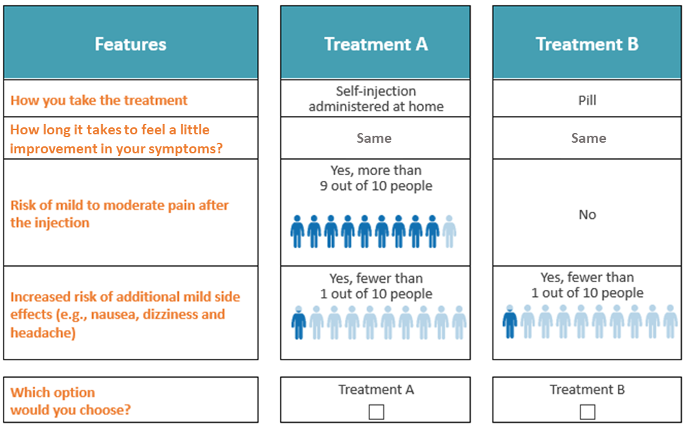

P-16
Route of administration preferences of people living with hereditary angioedema for on-demand treatment: A US-based qualitative study
Don Bukstein,¹ Vibha Desai,² Ledia Goga,² Shawn Czado,³ Michelle Brown,⁴ Kelley Myers,⁴ Paul Audhya,² Laurence Bouillet,⁵
¹The PBL Institute, Madison, Wisconsin, USA; ²Global Medical Affairs/Outcomes Research, KalVista Pharmaceuticals, Inc., Cambridge, Massachusetts, USA; ³Global Market Access, KalVista Pharmaceuticals, Inc., Cambridge, Massachusetts, USA; ⁴ RTI International, Inc., North Carolina, United States; ⁵Internal Medicine, Grenoble Alpes University, National Reference Center for Angioedema, Grenoble, France
Background
Results
Hereditary angioedema (HAE) is characterized by recurrent and unpredictable episodes of subcutaneous or submucosal swelling which can affect the abdomen, extremities, genitals, face, and larynx¹³
All currently approved HAE on-demand treatments must be administered parenterally, which results in significant treatment burden
Table 1. Respondent Characteristics
Table 3. Responses to Trade-off Scenarios
Characteristics | Adolescents (n = 10) | Adults (n = 10) | Total (N = 20)
Age, mean years (SD) [min-max] | 15.5 (1.5) [12-17] | 36.7 (16) [18-60] | 26.1 (8.9) [12-60]
Gender, n (%)
Female | 5 (50) | 6 (60) | 11 (55)
Male | 5 (50) | 4 (40) | 9 (45)
Race/ethnicity, n (%)
African American or Black | 1 (10) | 1 (10) | 2 (10)
Hispanic, Latin American, or Latinx | 4 (30) | — | 4 (20)
Middle Eastern or North African | — | 1 (10) | 1 (5)
White | 5 (50) | 8 (80) | 13 (65)
Age at HAE diagnosis, mean years (SD) | 6.7 (4.3) | 17.2 (12) | 11.9 (8.3)
HAE type 1, n (%) | 10 (100) | 7 (70) | 17 (85)
Number of attacks, last 6 months, n (SD) | 4.4 (5.1) | 4.5 (5.0) | 4.5 (5.0)
Most recent attack location, n (%)
Face | 1 (10) | — | 1 (5.0)
Extremities | 3 (30) | 4 (40) | 7 (35)
Abdomen | 5 (50) | 4 (40) | 9 (45)
Throat | 1 (10) | 2 (20) | 3 (15)
Lifetime specific attack location, n (%)
Abdominal | 8 (80) | 9 (90) | 17 (85)
Throat | 4 (40) | 6 (60) | 10 (50)
Current type of HAE treatment, n (%)
On-demand treatment and LTPT | 8 (80)^{c} | 5 (50) | 13 (65)
On-demand treatment only | 2 (20) | 5 (50) | 7 (35)
On-demand treatment used for most recent attack, n (%)
Firazyr, icatibant ª | 1 (10) | 8 (80) | 9 (45)
Berinert | 3 (30) | 1 (10) | 4 (20)
Ruconest, conestat alfa | 3 (30) | — | 3 (15)
Used LTPT^{b} | 3 (30) | 1 (10) | 4 (20)
 | Adolescents (n = 10) | Adults (n = 10) | Total (N = 20)
Treatment choice, n (%)
Treatment A (self-administered injection) | — | — | —
Treatment B (oral) | 10 (100) | 10 (100) | 20 (100)
Reasons for treatment B, n (%) ª
Less pain/burning | 5 (30) | 5 (50) | 10 (50)
Convenient to take/carry | 3 (30) | 4 (40) | 7 (35)
4 hours before second dose | 4 (40) | 2 (20) | 6 (30)
Safer (due to no injection/infusion) | 1 (10) | — | 1 (5)
No needles | 1 (10) | 1 (10) | 2 (10)
Less time to take | 2 (20) | 1 (10) | 3 (15)
“What if” scenarios…
Treatment A offered “substantial improvement” (vs. Treatment B, “little improvement”) within the same timeframe, n (%)
Treatment A choice | 9 (90) | 8 (80) | 17 (85)
Treatment B choice | 1 (10) | 2 (20) | 3 (15)
The risk for mild side effects was higher for Treatment B? Odds before switching to Treatment A, n (%) ^{b}
< 5 in 10 | 2 (20) | 3 (30) | 5 (25)
≥ 5 in 10 | 8 (80) | 7 (70) | 15 (75)
Objective
The objectives of this qualitative study were to understand patients’ likes and dislikes related to their current on-demand treatment, their attack experiences and route of administration (ROA) preferences for on-demand treatment
Methods
The US Hereditary Angioedema Association (HAEA) recruited people living with type 1 or type 2 HAE to be interviewed
Participants were not informed of the identity of the study sponsor
Study population included both adults (18 to 69yrs) and adolescents (12 to 17yrs); has had at least one HAE attack within the past six months; currently taking on-demand treatment (C1-INH replacement or bradykinin receptor B2 antagonist or kallikrein inhibitor)
The sampling plan aimed to obtain half of each age group currently taking both on-demand treatment and long-term prophylaxis (LTP) and half taking only on-demand treatment
Open-ended questions were asked to participants to understand their likes and dislikes associated with their current on-demand treatment
Open-ended questions were then asked to understand the trade-offs patients are willing to make when choosing a preferred ROA. Hypothetical self-administered injection and oral on-demand treatments were initially presented with similar efficacy and tolerability/mild side-effect risk profiles (Figure 1), which were then made better/worse depending upon participants’ initial treatment choice
Profiles were based on on-demand injection treatments’ US package inserts and clinical trial data for oral on-demand treatment in development
SD = standard deviation.
ª Multiple response question; percentages sum to greater than 100% per column.
^{b} When 14 participants were asked about the specific side effects of headache, nausea, and dizziness, 9 participants reported that they were more likely to tolerate a headache; 5 participants reported that they were less likely to tolerate a headache.
LTPT = long-term prophylactic treatment; SD = standard deviation.
ª While indicated for individuals aged 18 years and older, 1 adolescent (aged 15 years) reported recent first-time use of Firazyr for their on-demand treatment.
^{b} One adult (Haegarda) and 3 adolescents (Haegarda, Orladeyo, Takhzyro) reported using their LTPT as an on-demand treatment for their most recent attack. At screening, these participants reported use of Firazyr (n = 1) and Berinert (n = 3) as their current on-demand treatment.
^{c} Although the sampling plan aimed to obtain half of each age group currently taking both on-demand treatment and LTPT and half taking only on-demand treatment, this was not able to be achieved in the adolescent cohort.
Table 2. Reported “Likes” and “Dislikes” of Most Recent Acute Attack Treatment by Mode of Administration ª
Characteristic | Adolescents ^{b}, n (%) |  |  |  | Adults ^{c}, n (%) |  |  | Total, n (%)
 | SCI (n = 3) | IVI (n = 6) | Pill (n = 1) | Total (n = 10) | SCI (n = 9) | IVI (n = 1) | Total (n = 10) | SCI (n = 12) | IVI (n = 7) | Pill (n = 1) | Total (N = 20)
Likes ^{d ,} n (%)
Effective/reliable; “it works” | — | 4 (67) | 1 (100) | 5 (50) | 8 (89) | — | 8 (80) | 8 (80) | 4 (40) | 1 (100) | 13 (65)
Feeling of the medicine going in (emotional relief; mostly IV) | — | 3 (50) | — | 3 (30) | — | — | — | — | 3 (30) | — | 3 (15)
Easy to inject (intravenous and subcutaneous) | — | 1 (17) | — | 1 (10) | 1 (11) | — | 1 (10) | 1 (10) | 1 (10) | — | 2 (10)
Familiar/comfortable | — | 1 (17) | — | 1 (10) | — | — | — | — | 1 (10) | — | 1 (5)
Easy to constitute (e.g., referenced previous more cumbersome process) | — | 1 (17) | — | 1 (10) | — | — | — | — | 1 (10) | — | 1 (5)
SCI (vs. IVI) | 1 (10) | — | — | 1 (10) | 1 (11) | — | 1 (10) | 1 (10) | 1 (10) | — | 2 (10)
Cost (e.g.,” affordable”) | — | — | — | — | 1 (11) | — | 1 (10) | 1 (10) | — | — | 1 (5)
Portable | — | — | 1 (100) | 1 (10) | 2 (22) | — | 2 (20) | 2 (20) | — | 1 (100) | 3 (15)
Dislikes ^{d} , n (%)
Painful/burning injection | 1 (33) | 3 (50) | — | 4 (40) | 3 (33) | — | 3 (30) | 4 (40) | 3 (30) | — | 7 (35)
Takes too long to work (efficacy) | 1 (33) | 1 (17) | — | 2 (20) | 3 (33) | — | 3 (30) | 4 (40) | 1 (10) | — | 5 (25)
Cannot easily take with you (refrigeration and travel) | 1 (33) | — | — | 1(10) | 3 (33) | — | 3 (30) | 4 (40) | — | — | 4 (20)
Needles/injections (fear/avoidance) | — | — | — | — | 3 (33) | — | 3 (30) | 3 (30) | — | — | 3 (15)
Burden/hassle of administration (i.e., time commitment; refrigeration; preparation) | — | 2 (33) | — | 2 (20) | 2 (22) | 1 (100) | 3 (30) | 2 (20) | 3 (30) | — | 5 (25)
Dependent on others for administration | — | 2 (33) | — | 2 (20) | — | — | — | — | 2 (20) | — | 2 (10)
Body-weight sensitive (i.e., 1 participant was administered too low of a dose due to a recent weight gain) | — | 1 (17) | — | 1 (10) | 1 (11) | — | 1 (10) | 1 (10) | 1 (10) | — | 2 (10)
Same infusion site (e.g., they would like to be able to inject in other places) | 1 (33) | 1 (17) | — | 2 (20) | — | — | — | 1 (10) | 1 (10) | — | 2 (10)
High cost | — | — | — | — | 1 (11) | — | 1 (10) | 1 (11) | — | — | 1 (5)
Figure 1. Hypothetical Trade-off Scenario
IV = intravenous; IVI = intravenous infusion; SCI = subcutaneous injection.
ª Reported likes and dislikes were based on the treatment used for their most recent attack, including 4 participants who used a long-term prophylactic treatment.
^{b} Ten adolescents took Firazyr (n = 1, SCI), Haegarda (n = 1, SCI), Takhzyro (n = 1, SCI), Berinert (n = 3, IVI), Ruconest (n = 3), and Orladeyo (n = 1, pill).
^{c} Ten adults took Firazyr (n = 8, SCI), Haegarda (n = 1, SCI), and Berinert (n = 1, IVI).
^{d} Multiple response question; percentages sum to greater than 100% per column.
Conclusions
All participants preferred the hypothetical oral on-demand treatment over hypothetical self-administered injection on-demand treatment when efficacy and tolerability/mild side-effect risk were the same
In the hypothetical comparison, self-administered injection was only preferred over oral on-demand treatment if it offered substantially better efficacy over oral treatment, and only if the oral treatment had substantively worse tolerability/mild side-effect risk than observed in available clinical studies
Quantitative analyses in a larger cohort are warranted to better refine on-demand treatment preferences, for shared decision-making
References
Bork K, Anderson JT, Caballero T, Craig T, Johnston DT, Li HH, et al. Assessment and management of disease burden and quality of life in patients with hereditary angioedema: a consensus report. Allergy Asthma Clin Immunol. 2021; 17: 40
Disclosures
This study was sponsored by KalVista Pharmaceuticals, Inc. All authors met the ICMJE authorship criteria and had full access to relevant data. The authors had full editorial control of the data presented and provided final approval of all content. Neither honoraria nor payments were made for authorship.
Don Bukstein – Reports being a speaker for Regeneron.
Vibha Desai – Employee of KalVista Pharmaceuticals, Inc.
Ledia Goga – Employee of KalVista Pharmaceuticals, Inc.
Shawn Czado – Employee of KalVista Pharmaceuticals, Inc.
Michelle Brown – Employee of RTI-Health Solutions.
Kelley Myers – Employee of RTI-Health Solutions.
Paul Audhya – Employee of KalVista Pharmaceuticals, Inc.
Laurence Bouillet – Reports grants and personal fees from Takeda, Biocryst, Behring, Blueprint, GSK.
Presented: 13th C1-Inhibitor Deficiency & Angioedema Workshop, May 4-7, 2023, in Budapest, Hungary.
Please scan this QR code to view the poster after the congress.

