Slide 1
Real-World Barriers to On-Demand Treatment for Attacks in Hereditary Angioedema: A Patient Survey
Daisuke Honda¹, Sandra Christiansen², Julie Ulloa³, Sherry Danese³, Vibha Desai⁴, Tomas Andriotti^{4*}, Shigeru Yoshida⁴, Paul Audhya⁴, Michihiro Hide⁵
¹Chiba University Graduate School of Medicine, Chiba, Japan; ²University of California San Diego, La Jolla, CA, United States; ³Outcomes Insights, Agoura Hills, CA, United States; ⁴KalVista Pharmaceuticals, Cambridge, MA, United States; ⁵Hiroshima City Hiroshima Citizens Hospital, Hiroshima, Japan
*Employee of KalVista Pharmaceuticals at the time the study was conducted

Slide 2
Disclosures
Daisuke Honda has received honoraria as a speaker and advisor from KalVista, BioCryst, CSL Behring, Takeda, and Torii
This study was funded by KalVista Pharmaceuticals

Slide 3
Background
Hereditary angioedema (HAE) is characterized by unpredictable swelling attacks that affect cutaneous and submucosal tissues and are typically painful, debilitating, and potentially fatal
WAO/EAACI 2021 updated guidelines recommend the early use of on-demand treatment following attack recognition to reduce morbidity and prevent mortality¹⁻³
Despite the recommendation for early treatment, recent research suggests that patients delay on-demand treatment of their HAE attacks⁴
The current analysis aimed to identify the burdens and potential barriers to subcutaneous on-demand treatment
1. Betschel S, Badiou J, Binkley K, et al. The International/Canadian Hereditary Angioedema Guideline. Allergy, Asthma & Clinical Immunology. 2019/11/25 2019;15(1):72. doi:10.1186/s13223-019-0376-8
2. Busse PJ, Christiansen SC, Riedl MA, et al. US HAEA Medical Advisory Board 2020 Guidelines for the Management of Hereditary Angioedema. The Journal of Allergy and Clinical Immunology In Practice. Jan 2021;9(1):132-150.e3. doi:10.1016/j.jaip.2020.08.046
3. Maurer M, Magerl M, Betschel S, et al. The international WAO/EAACI guideline for the management of hereditary angioedema-The 2021 revision and update. Allergy. Jul 2022;77(7):1961-1990. doi:10.1111/all.15214
4. Radojicic, Cristine et al. Patient Perspectives On Early Use Of On-demand Treatment For Hereditary Angioedema (HAE) Attacks to Reduce Severity

Slide 4
Methods
The US Hereditary Angioedema Association recruited participants with Type 1 or 2 HAE between April and June 2023
Participants had to be at least 12 years old and have treated at least 1 HAE attack within the prior 3 months with an approved on-demand therapy to be included in the survey
  Participants completed a 20-minute, self-reported, online survey that inquired about their last treated HAE attack
Analysis included a subgroup of participants who self-administered subcutaneous on-demand treatment

Slide 5
Participant Characteristics (Subcutaneous subgroup)
61 out of 94 (64.9%) participants who completed the survey treated their last attack with subcutaneous on-demand treatment
Participants who used subcutaneous on-demand treatment | Total (n=61)
Current age, years; mean (SD) | 46 (15.2)
Gender Male Female | 12 (20%) 49 (80%)
HAE Type Type I Type II | 48 (79%) 13 (21%)
On long-term prophylaxis at the time of their last attack | 34 (56%)

Slide 6
Long-Term Prophylaxis Agent Among Patients who Treated their Last Attack with Subcutaneous On-Demand Treatment
% of Respondents (n=34)

Slide 7
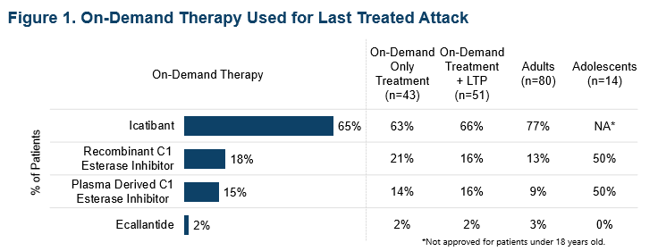
Time to on-Demand Treatment After Initial Attack Recognition
% of Respondents (n=61)
Mean reported time (standard deviation) from attack onset to on-demand treatment was
2.9 (3.6) hours

Slide 8
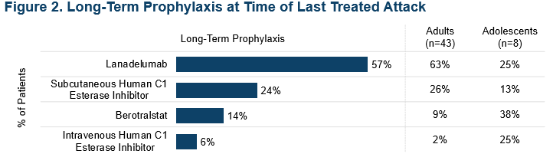
Barriers to Treating HAE Attack Sooner (Top 5 Ranked)
Respondents were asked to rank their top 5 reasons from a list of possible reasons for delaying the administration of on-demand treatment
Reasons for not treating earlier were reported by 53/61 (87%) patients*
4%
4%
* Excludes participants who treated all attacks immediately

Slide 9
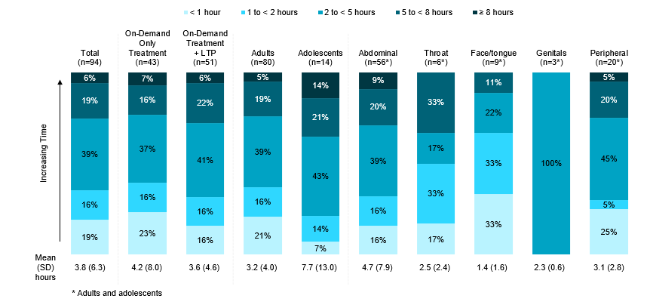
Reported Level of Anxiety Associated with Use of Subcutaneous On-demand Treatment
% of Respondents (n=61)
How much anxiety did you feel about treating this HAE attack with on-demand treatment (on a scale of 0-10)?
74% of respondents (45/61) reported experiencing mild to extreme anxiety about treating their most recent HAE attack with a subcutaneous on-demand therapy

Slide 10
Reported Reasons for Feeling Anxious About Treating Most Recent Attack with Subcutaneous On-Demand Treatment (Top 5 Ranked)
Respondents (n=45)* were asked to rank their top 5 reasons from a list of possible factors contributing to their anxiety about treating their most recent attack with on-demand treatment
* Excludes participants who were “Not Anxious”.

Slide 11
Conclusions
Results suggest that many patients with HAE who are prescribed subcutaneous on-demand treatment do not follow guideline recommendations for initiating treatment as soon as an attack is recognized
Reasons for delaying treatment included uncertainty whether the attack was real, desire to save on-demand treatment, thinking the attack would be mild, and wanting to avoid needle/injection pain
Most patients experienced anxiety about using on-demand treatment due to concerns about running out of treatment, uncertainty regarding its efficacy, and anticipating pain from the injection
Ready access to treatments with less invasive routes of administration, in addition to appropriate patient education, may help to overcome barriers to prompt on-demand treatment of HAE attacks

