Slide 1
Effectiveness of Sebetralstat for the On-demand Treatment of Mucosal HAE Attacks: Interim Analysis from KONFIDENT-S
Presenter: Henriette Farkas¹
Jonathan A. Bernstein,² Emel Aygören-Pürsün,³ Vesna Grivcheva-Panovska,⁴ Inmaculada Martinez-Saguer,⁵ Danny M. Cohn,⁶ William R. Lumry,⁷ Marc A. Riedl,⁸ Andrea Zanichelli, ^{9,10} Laurence Bouillet,¹¹ Ya-Hsiu Chuang,¹² Michael D. Smith,¹² Christopher M. Yea,¹² Paul K. Audhya¹²
¹Hungarian Angioedema Center of Reference and Excellence, Semmelweis University, Budapest, Hungary; ²University of Cincinnati College of Medicine; and Bernstein Clinical Research Center, Cincinnati, OH, USA; ³University Hospital Frankfurt, Goethe University Frankfurt, Frankfurt, Germany; ⁴University Clinic of Dermatology, School of Medicine, University Saints Cyril and Methodus, Skopje, North Macedonia; ⁵HZRM Haemophilia Center Rhein Main, Frankfurt, Germany; ⁶Amsterdam University Medical Center, University of Amsterdam, Amsterdam, Netherlands; ⁷AARA Research Center, Dallas, TX, USA; ⁸University of California, San Diego, La Jolla, CA, USA; ⁹Operative Unit of Medicine, Angioedema Center, IRCCS Policlinico San Donato, San Donato Milanese, Milan, Italy; ¹⁰Department of Biomedical Science for Health, University of Milan, Milan, Italy; ¹¹French National Reference Center for Angioedema (CREAK), Grenoble Alpes University, Grenoble, France; ¹²KalVista Pharmaceuticals, Salisbury, United Kingdom, and Cambridge, MA, USA.

Slide 2
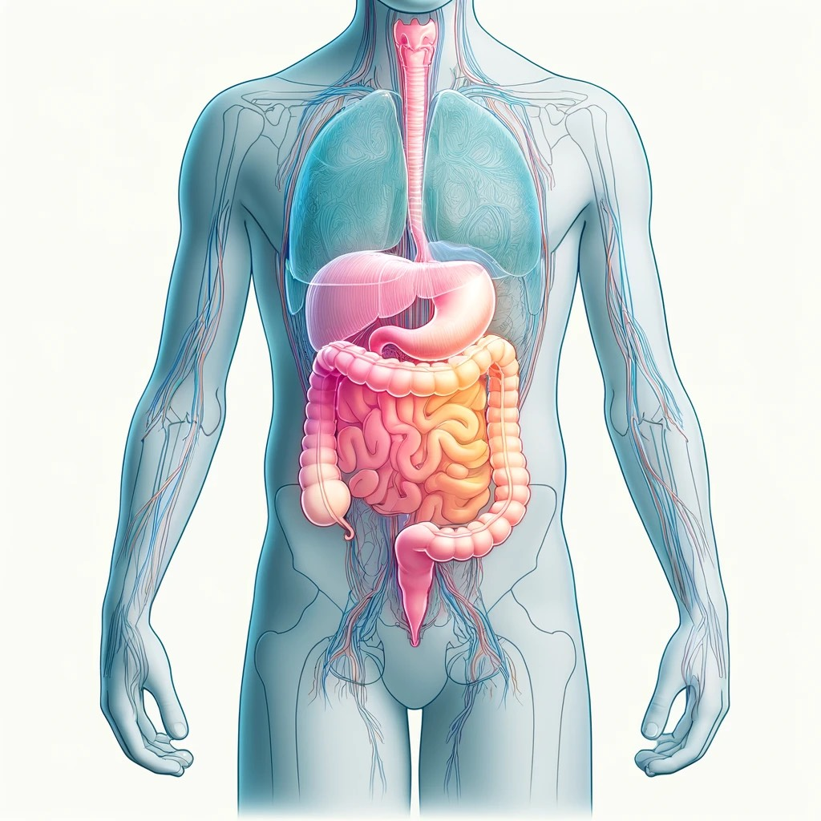
Background
HAE-C1INH attacks involving gastrointestinal and laryngeal tissues share an underlying pathophysiology because they affect the submucosal lining of internal surfaces¹⁻⁸
Mucosal attacks may progress rapidly and are associated with substantial morbidity^{9,10}
Gastrointestinal attacks lead to severe pain, nausea, vomiting, and in some cases, may result in circulatory shock due to hypovolaemia or temporary obstruction due to the thickening of the bowel wall^{9,11}
In the larynx, even minor oedema can rapidly progress to life-threatening airway compromise³⁻⁵
Here we present interim data on the safety and effectiveness of sebetralstat, an investigational oral on-demand therapy, in mucosal attacks from the ongoing 2-year open-label KONFIDENT-S study

Slide 3
KONFIDENT-S Open-label Extension Study Design
End-of-study visit
Inclusion criteria:
≥12 years of age
≥2 documented HAE attacks within 3 months
Treatment period (0-24 months)
Monthly visits
Quarterly
visits
Treatment:
Participants were instructed to self-administer sebetralstat 600 mg (2 x 300-mg tablets) as early as possible after HAE attack onset
A second administration was allowed if warrantedª
In-clinic
All other months
Endpoints:
Safety (adverse events)
Time to beginning of symptom relief (by PGI-C)^{b}
Time to first reduction in severity (by PGI-S)^{b}
Time to complete attack resolution (by PGI-S)^{c}
Televisit
Months
0
3
4
21
23
24
Multiple real-world elements were incorporated into the trial design, including televisits, portable multidose packs, and the elimination of a need to contact a call centre or investigator before, during, or after attacks.

Slide 4
Participant Demographics and Sebetralstat-treated Attack Characteristics
 | Participants Experiencing
 | Laryngeal Attacksª n=16 | Abdominal Attacks n=102^{b}
Age, mean (range), years | 43.4 (15 – 67) | 36.8 (12 – 77)
Age group, <18 years old, n (%) | 2 (12.5) | 17 (16.7)
Sex, female, n (%) | 10 (62.5) | 71 (69.6)
Race, n (%)
White | 13 (81.3) | 76 (74.5)
Asian | 2 (12.5) | 13 (12.7)
Other | - | 6 (5.9)
Not reported | 1 (6.3) | 7 (6.9)
BMI, mean (range), kg/m² | 29.66 (19.5 – 41.5) | 25.92 (16.7 – 41.5)
HAE-C1INH-Type 1, n (%) | 16 (100) | 95 (93.1)
Current treatment regimen, n (%)
On-demand only | 9 (56.3) | 77 (75.5)
On-demand + LTP | 7 (43.8) | 25 (24.5)
Kallikrein-inhibiting agent^{e} | 6 (85.7) | 21 (84.0)
C1INH | 1 (14.3) | 4 (16.0)
Time since diagnosis, median (IQR), years | 16.6 (6.1 – 25.0) | 12.6 (6.0 – 22.5)
 | Laryngeal Attacks n=32 | Abdominal Attacks n=533
Baseline PGI-S rating, n (%)
Mild | 8 (25.0)^{c} | 158 (29.7)^{d}
Moderate | 15 (46.9) | 227 (42.6)
Severe/very severe | 9 (28.1) | 148 (27.7)

Slide 5
Time to Treatment
Time from attack onset to sebetralstat administration
Median (IQR) time from attack onset to sebetralstat administration was 11.5 minutes (1.0 – 34.0) for laryngeal attacks and 20.0 minutes (1.0 – 61.0) for abdominal attacks
81.3% of laryngeal attacks and 70.5% of abdominal attacks were treated in <1 hour of onset
Laryngeal Attacks
23 (71.9%)
Abdominal Attacks
302 (56.7%)
Proportion of sebetralstat-treated attacks
157 (29.5%)
6 (18.8%)
74 (13.9%)
3 (9.4%)

Slide 6
Effectiveness of Sebetralstat
Endpoint | Laryngeal Attacks | Median (IQR), h |  | Abdominal Attacks | Median (IQR), h
Time to beginning of symptom reliefª |  | 1.29 (0.76 – 3.02) |  |  | 1.27 (0.76 – 3.54)
Time to reduction in attack severityª |  | 4.25 (1.22 – >12) |  |  | 3.52 (1.26 – >12)
Time to complete attack resolution^{b} |  | 12.69 (5.11 – >24) |  |  | 15.17 (4.46 – >24)
Time, hours^{c}
Time, hours^{c}
 | Laryngeal Attacks n=32 | Abdominal Attacks n=533
Attacks treated with an additional dose within 12 hours, n (%) | 4 (12.5) | 95 (17.8)
Attacks treated with conventional treatment within 12 hours, n (%) | 3 (9.4) | 43 (8.1)
Proportion of attacks reaching beginning of symptom relief within 12 hours before or without an additional dose^{d} | 96.0% | 95.8%

Slide 7
Safety of Sebetralstat
 | Laryngeal Attacks n=16 | Abdominal Attacks n=102
Any TEAE, n (%) | 7 (43.8) | 36 (35.3)
Treatment-related | 1 (6.3)ª | 6 (5.9)^{a,b}
Serious TEAE, n (%)^{c} | 2 (12.5)^{e} | 2 (2.0)
Treatment-related | 0 | 0
Severe TEAE, n (%)^{d} | 3 (18.8) | 2 (2.0)
Treatment-related | 0 | 0
Any TEAE leading to permanent discontinuation, n (%) | 1 (6.3) | 2 (2.0)
Any TEAE leading to death, n (%) | 0 | 0
No participants reported difficulty swallowing sebetralstat during laryngeal or abdominal attacks

Slide 8
Conclusion
Sebetralstat demonstrated similar effectiveness for laryngeal and abdominal mucosal HAE attacks
Sebetralstat has demonstrated a favourable safety profile across multiple clinical studies and analyses, and was well-tolerated as treatment for mucosal attacks
Oral sebetralstat enabled rapid self-administration, resulting in early symptom relief and shorter attack duration in patients with HAE-C1INH

Slide 9
Acknowledgements
We thank the people living with HAE and their families and the investigator teams who contributed to the international KONFIDENT-S study
Medical writing assistance was provided under the direction of the authors by Nazli Bashiri, MA, of ApotheCom (San Francisco, CA) and was supported by KalVista Pharmaceuticals

Slide 10
Appendix

Slide 11
Efficacy Endpoints
Primary efficacy endpoint: time to beginning of symptom relief, defined as a rating of at least ‘A Little Better’ on the PGI-C scale for ≥2 consecutive time points within 12 hours
Patient Global Impression of Change (7-point scale)
PGI-C
Much Worse
Worse
A Little Worse
No Change
A Little Better
Better
Much Better
Key secondary endpoints were tested hierarchically in the following order
Time to reduction in attack severity, defined as a decrease in PGI-S score for ≥2 consecutive time points within 12 hours
Time to complete attack resolution, defined as PGI-S rating of ‘None’ within 24 hours
Patient Global Impression of Severity (5-point scale)
PGI-S
Very Severe
Severe
Moderate
Mild
None

